Slide 1

Welcome to YSC2239!
Hengnan (Henry) Hu
Spring 2023

Slide 2
Today’s class
Course organization
Introduction: What is Data Science?
Jupyter notebook for Python
Demo: Huckleberry Fin, Little Women

Slide 3
Course staff
Instructor:
Hengnan Hu
Email: henry.hu@nus.edu.sg
Office Hours: By appointment over Zoom
Lectures:
Time: Monday, Thurs 7pm – 8:30pm
Location: Y-LT1
Remotely (need to check with IT and update over Canvas)

Slide 4
Course staff (Peer tutors)
•John Jacob Go
Email: | jacobgo@u.yale-nus.edu.sg
•Nihal Zuhayar Parash Miaji
Email: | nihalzuhayar@u.yale-nus.edu.sg

Slide 5
Weekly drop-in sessions
Weekly drop-in sessions will begin on Week 2
Detailed schedule and venue: TBA

Slide 6
Social distancing policy
We suggest the following social distancing policy:
1. Wear masks in lectures, drop-in sessions and
2. Keep appropriate distance between you and other classmates, peer tutors and professors
3. Maintain good personal hygiene at all times

Slide 7
Course contents
Introduction of Python for data science: tables, data types, charts, histograms, functions, groups, joins, iteration
Statistics: chance, sampling, models, distributions, A/B testing, confidence intervals, central limit theorem, correlation, p-values
Machine learning: linear regression, multiple linear regression, regression diagnostics, feature engineering, logistic regression, classification, clustering, decision tree

Slide 8
Course resources
We will follow the lecture slides and demo of the instructor.
I strongly encourage bringing your laptop to lecture and play around with the demo yourself in real-time for best learning experience.

Slide 9
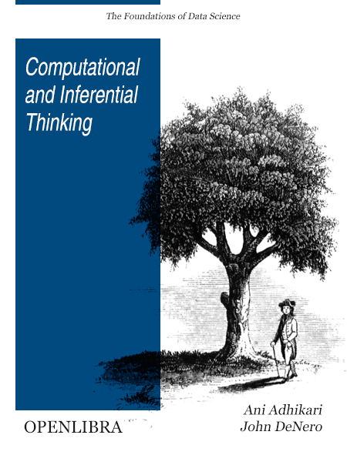
Course resources
Text for the first-half:
Title: Computational and Inferential Thinking: The Foundations of Data Science
Authors: Ani Adhikari and John DeNero
Link: https://inferentialthinking.com/chapters/intro.html
We will use Canvas for communication and posting of material

Slide 10
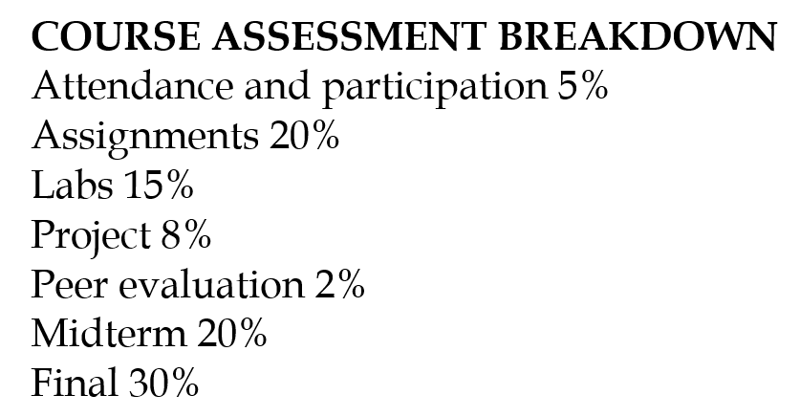
Assessment Scheme

Slide 11
Assessment Scheme
Attendance: QR code at the beginning of each lecture + 4 in-class quizzes
Assignments: weekly in the first half of the course. First assignment will be posted on Week 2, due on Friday 23:59.
Labs: weekly. First lab will be posted on Week 1, due on Wednesday 23:59.
Midterm exam: March 2nd (Thursday) 7pm – 8:30pm, lecture-time, in-person. Please block this timeslot. No make-up exams will be given for midterm exam.
Final exam: April 28th (Friday) 3pm – 5pm, please take note this timeslot. No make-up exams will be given for final exam.

Slide 12
Project
The course culminates in a final group project in which students are expected to create appropriate data science models using the methods covered in class for data analysis. Each group composes of 2-3 students, except in special circumstances approved by the instructor.
Further details on the projects will be provided as the due dates approach.

Slide 13
Late work policy
Checkout the syllabus on penalty for late work policy

Slide 14
Other policies and resources
Checkout the syllabus on penalty for academic integrity policy, intellectual property and privacy, class climate, etc.

Slide 15
Today’s class
Course organization
Introduction: What is Data Science?
Jupyter notebook for Python
Demo: Huckleberry Fin, Little Women

Slide 16
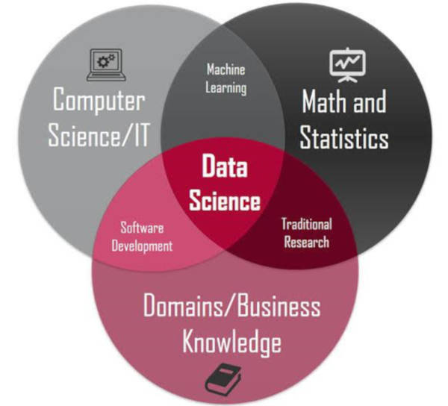
Data Science
Reading: Book Chapter 1

Slide 17
Data is the new oil
We now live in a time of big data
Ability to leverage these data to make intelligent decisions and to help designing faster and better algorithms are very important
A wide range of fields that rely on data-driven decision making, e.g. Biology, Economics, self-driving cars etc..

Slide 18
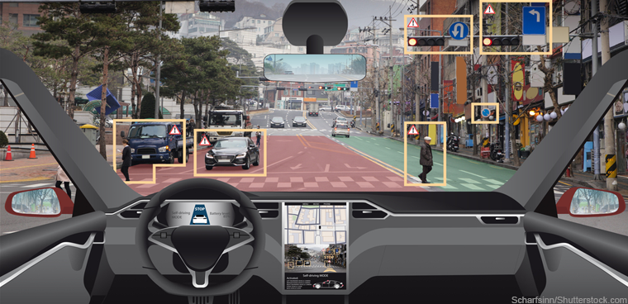
Applications of data science: computer vision and self-driving cars

Slide 19
Applications of data science: accelerate scientific discovery in protein folding
Google Deepmind has developed AlphaFold that can accurately predict 3D models of protein structures and is accelerating research in nearly every field of biology:
https://www.deepmind.com/research/highlighted-research/alphafold

Slide 20
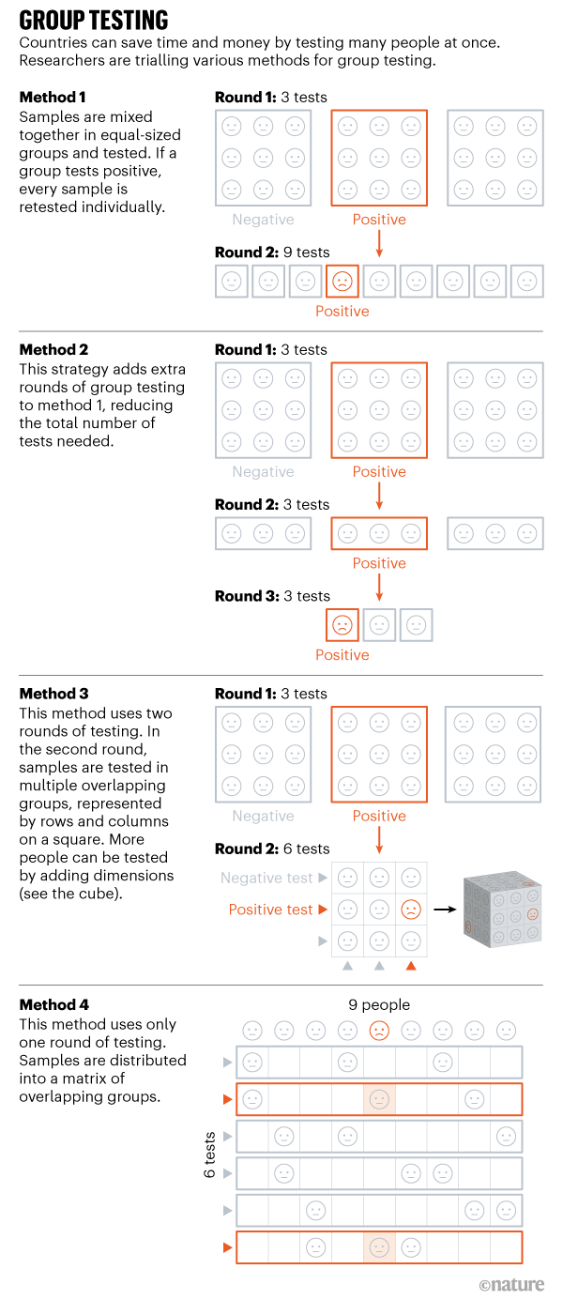
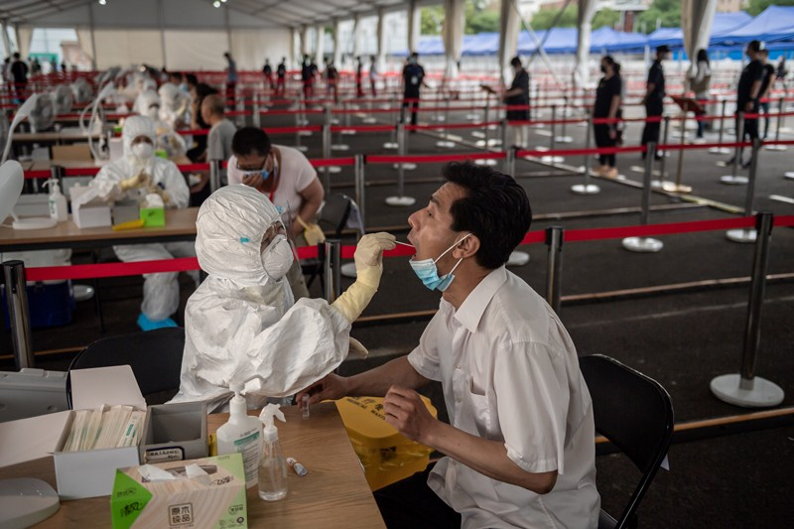
Applications of data science: combat COVID-19
Group testing
https://www.nature.com/articles/d41586-020-02053-6

Slide 21
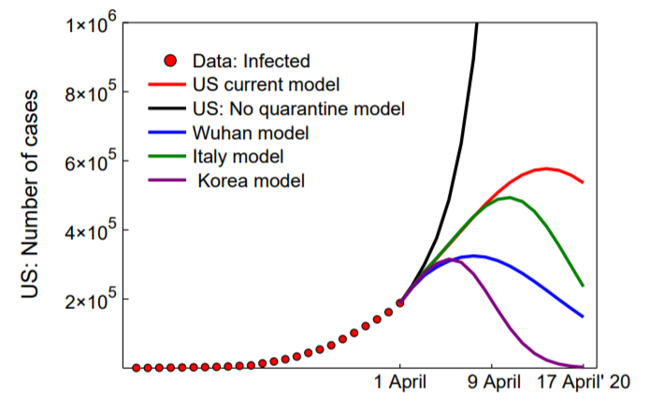
Applications of data science: combat COVID-19
Forecasting models
https://projects.fivethirtyeight.com/covid-forecasts/

Slide 22
Today’s class
Course organization
Introduction: What is Data Science?
Jupyter notebook for Python
Demo: Huckleberry Fin, Little Women

Slide 23
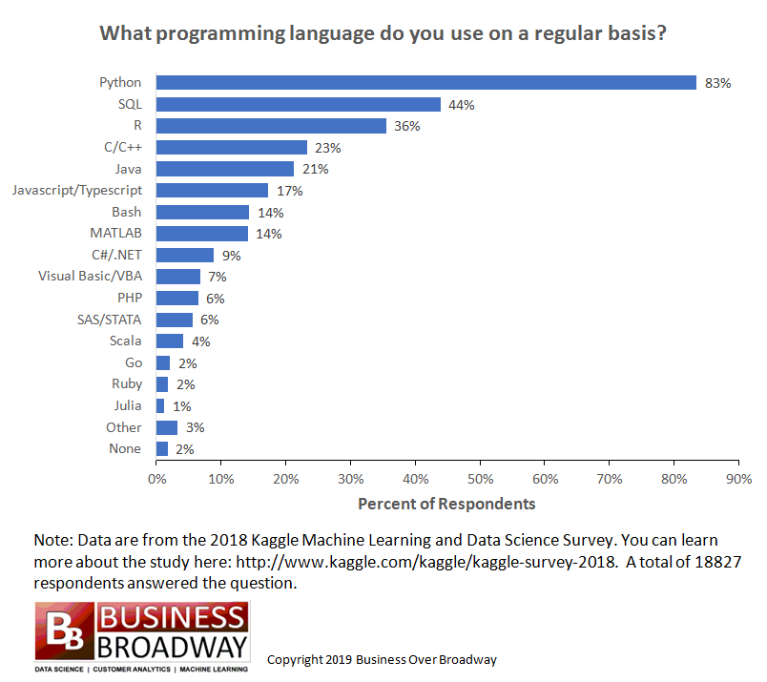
Python
Python is a very popular computing language for data science and software development

Slide 24

Jupyter notebook
In this course, we will be using Jupyter notebook with Python 3 for all of the Labs, Assignments and Exams!
Install the latest version: https://www.anaconda.com/distribution/
Checkout the installation guide on Canvas
Please let the instructors or peer tutors know if you have any issue on installation

Slide 25
datascience package in Python
We shall need the datascience package in Python for the first half of the course
Checkout the installation guide on Canvas

Slide 26
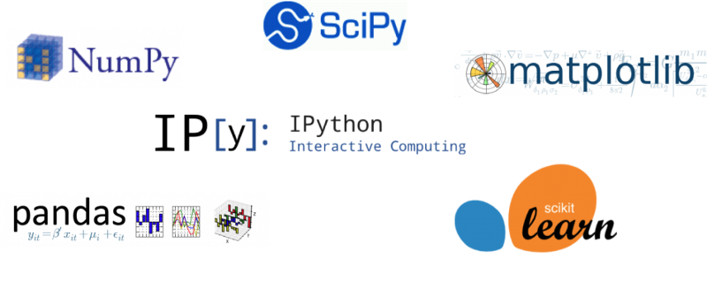
Python packages that we will learn in this course
Datascience
Pandas
Scikit-learn
NumPy
Matplotlib

Slide 27


Today’s class
Course organization
Introduction: What is Data Science?
Jupyter notebook for Python
Demo: Huckleberry Fin, Little Women

Slide 28
To do
Install Jupyter notebook and the datascience package
Lab 0 (ungraded)

